Slide 1

AMEX Working Capital Report
Financial Ananlysis of AMEX Customer Segment
By:- Tejus Kumar Sharma
Email Id:- Tejussharma7898.ts@gmail.com

Slide 2

Problem Statement
American Express dataset provided for financial performance analysis.
Need to evaluate Revenue, Net Income, Expenses, and Delinquency trends.
Understand performance by Region and Segment (Consumer, Small Biz, Corporate).
Deliver actionable insights for growth, risk monitoring, and customer behavior.

Slide 3

Dataset Overview

Slide 4

Source: American Express financial & operational dataset (Excel format).
Time Period Covered: Quarterly data across multiple years.
Granularity: Organized by Region (e.g., North America, Europe, Asia) and Segment (Consumer, Small Biz, Corporate).
Key Variables:
Financials: Revenue ($M), Interest Income, Expenses, Net Income.
Customer Metrics: Active Cards (M), Avg Spend per Card ($).
Risk Indicator: Delinquency %.
Data Size: ~ (depends on your Excel rows, you can mention e.g., “~100 records covering multiple regions & years”).
Cleaning/Processing:
Column names standardized.
New KPIs engineered (Net Income Margin %, YoY Revenue Growth %, Revenue per Active Card, Delinquency-to-Revenue Ratio).
Exported as clean dataset for Power BI & analysis.

Slide 5


Key Business Questions Title: Key Business Questions Driving the Analysis
Revenue Performance:
How has Revenue grown year-on-year (YoY) across regions and segments?
Which segment contributes the highest revenue?
Profitability:
What is the Net Income Margin % across time and segments?
How do Expenses impact profitability trends?
Customer Insights:
What is the Revenue per Active Card across regions?
How does Avg Spend per Card vary by segment (Consumer, Small Biz, Corporate)?
Risk Monitoring:
What is the trend of Delinquency % over time?
Which regions/segments have higher delinquency risk relative to revenue?
Strategic Insights:
Where should the company focus for growth?
Which areas need risk mitigation and efficiency improvement?

Slide 6

Excel :
Initial data exploration and cleaning (removing inconsistencies, formatting).
Creation of pivot tables for quick aggregation (YoY revenue growth, segment trends).
Exporting cleaned dataset for further analysis.
Python :
Pandas & NumPy for advanced data cleaning, transformations, and KPI calculations (e.g., Revenue per Active Card, YoY Growth).Prepared data pipelines for reliable input into Power BI.
Power BI :
Built interactive dashboards for executives and stakeholders.
Used DAX measures for:
Net Income Margin %
YoY Growth %
Revenue per Active Card
Delinquency-to-Revenue Ratio
Created visuals: Treemap (Revenue by Region), Line Charts (Delinquency trend), Scatter (Risk vs Profitability).
Tools Used for Analysis

Slide 7
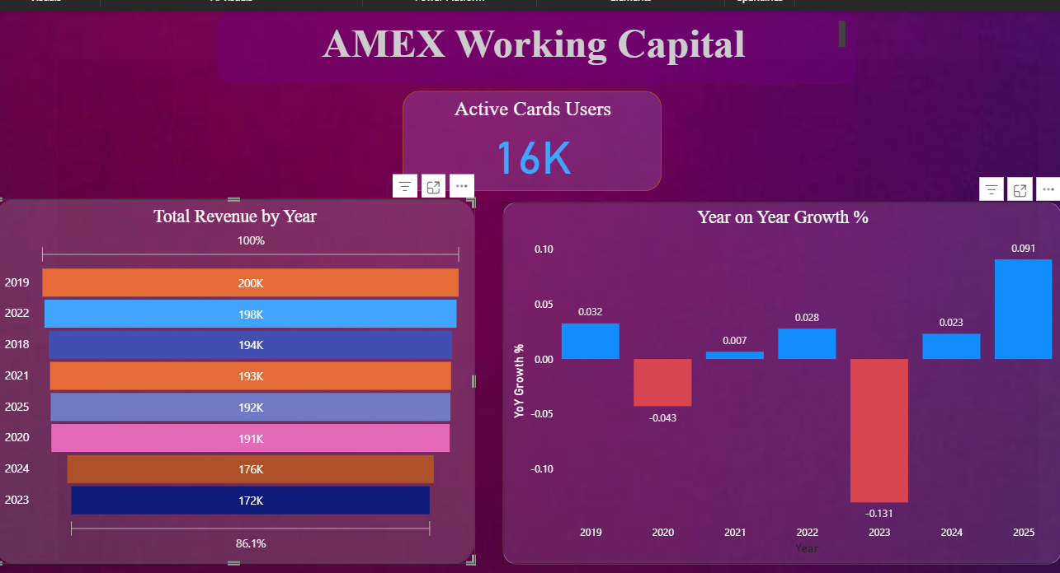
Dashboard Walkthrough
Regional Analysis Page: Revenue (Treemap), Delinquency % (Bar Chart).
Segment Analysis Page: Revenue vs Expenses, Avg Spend per Card.
Risk Monitoring Page: Delinquency % trend (Line), Net Income vs Delinquency (Scatter)

